Slide 1
Bawdsey Manor 2025

Slide 2
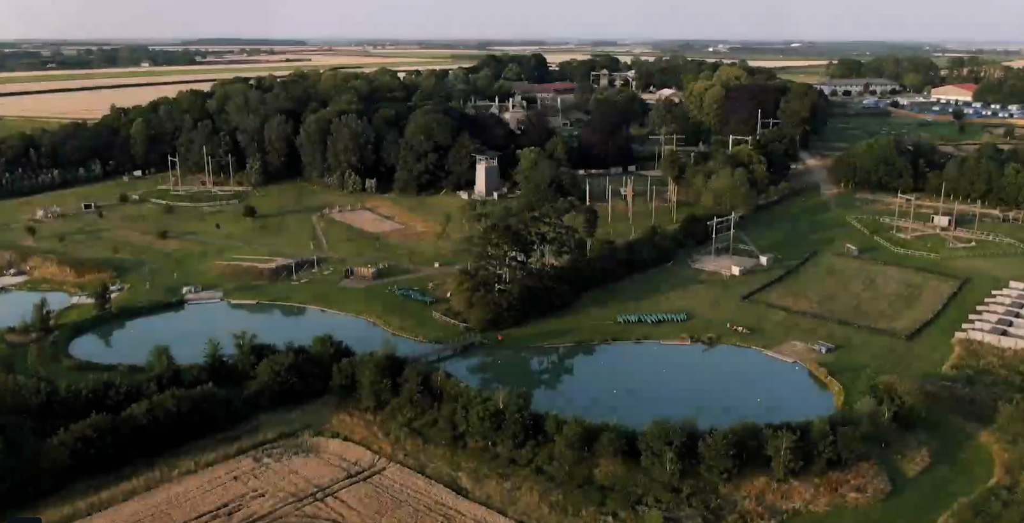

Slide 3
Adults attending the trip:
Mrs Barraclough
Mrs Fox
Mr Waller

Slide 4
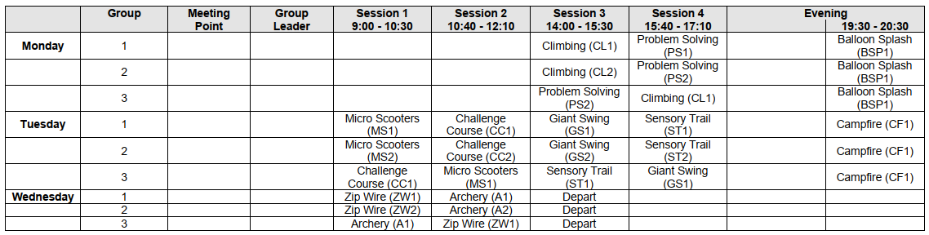
An example itinerary!

Slide 5
Kit list
Please make sure that all belongings are clearly named and can be easily carried by the children:
Sleeping bag and pillow with pillow case on
4 long sleeved tops/t-shirts (long sleeves are needed for the activities)
4 pairs of tracksuit bottoms/trousers (not jeans)
5 x underwear
5 pairs of socks (not trainer socks)
4 jumpers
Nightwear
2 pairs of trainers (these are likely to get muddy and wet)
1 x indoor shoes
1 wash Towel
1 towel for activities

Slide 6
Kit list cont.
Reusable drinks bottle
Rucksack- with drawing / reading / card games to play on journey- No electronics.
Bin bag for dirty clothing
Washbag – soap, shampoo, toothpaste, toothbrush, deodorant (roll on only)
Sun cream
Sun hat
Waterproof Coat
Up to £10 pocket money in a named purse /wallet
Packed lunch in a disposable bag.
Do not bring
Aerosols
Any electrical items
Food

Slide 7
Rooms
All the children will pick 3 friends
We will make sure they are with at least one of these.
We will tell them their rooms on the way to Bawdsey Manor

Slide 8
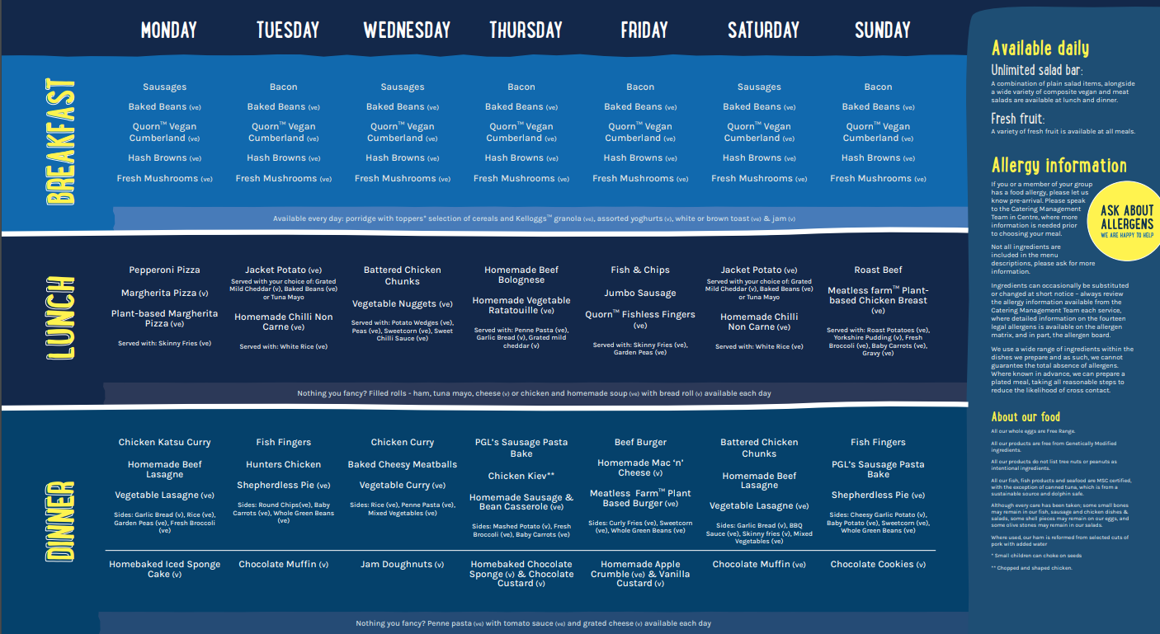
Example Menu

Slide 9
Contact
We will update you each evening when the activities have concluded. This will be approximately 9pm-10pm.
The update will be posted on Compass.
No adults will be contactable via Whats app. Please ring Mrs Grant in the office.

Slide 10
Parent Pack
Consent form
Medical form
All medicines including travel sickness tablets should be brought into the office with the correct paperwork by the Friday.
Any additional medicines that have been obtained over the weekend need to go to the school office on the Monday morning. These should only be those that were not known about before the weekend.

Slide 11
On the day!
Come to school normal time. Children come into class.
Coach will leave at 9:15am.
Return on the Wednesday at 4pm.

Slide 12
Any Questions?

